Slide 1
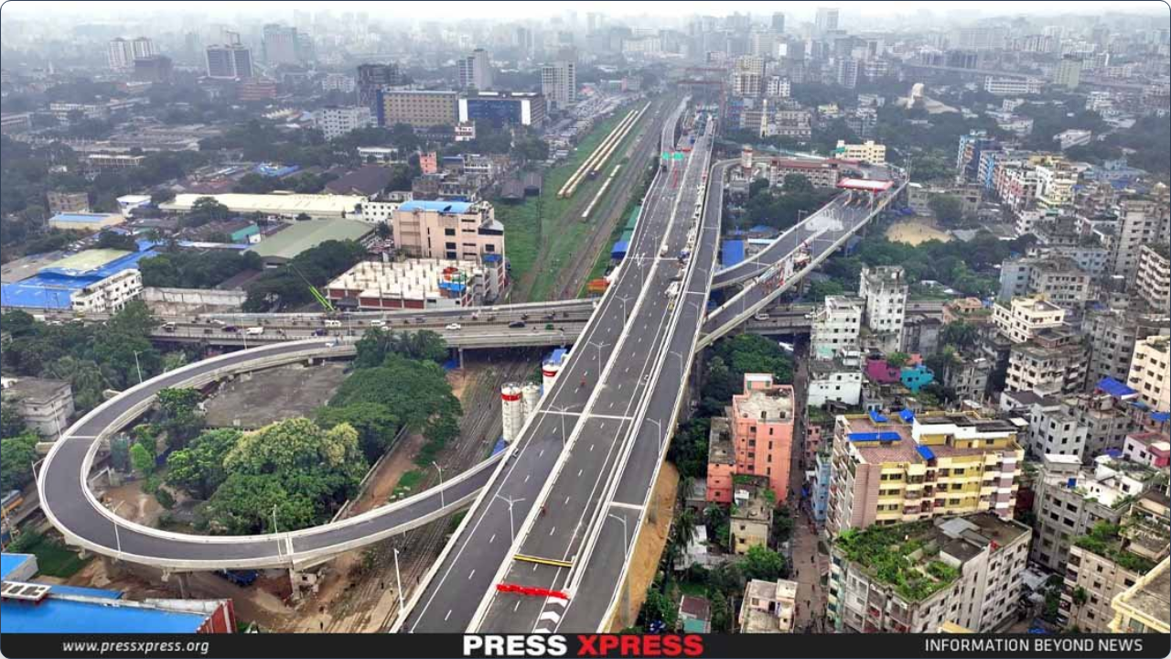

“Road Scene Analysis as a First-Person View (FPV)”

Slide 2
Categories of the most common actions
Frequent
Actions
Moderate Actions
Rare But Critical Actions
1. Sudden Lane Change by Other Vehicles.
2. Pedestrian standing on lane edge.
3. Vehicles coming from the opposite lane.
4. Traffic jam.
1. Person unexpectedly enters road.
2. Accident
3. Animals Crossing the Road.
4. Railway track on middle of the road.
1. Pedestrians Crossing.
2. Vehicle Overtaking.
3. Speed Breakers / Bumps / Potholes.

Slide 3
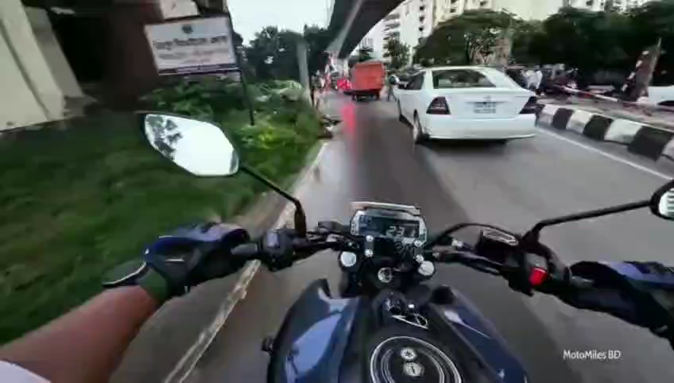
Pedestrian Crossing
This refers to people walking on or entering the road, whether at designated crossings or unexpectedly (jaywalking).
According to our observation
pedestrian crossing the road about 27 times from 8 videos.

Slide 4
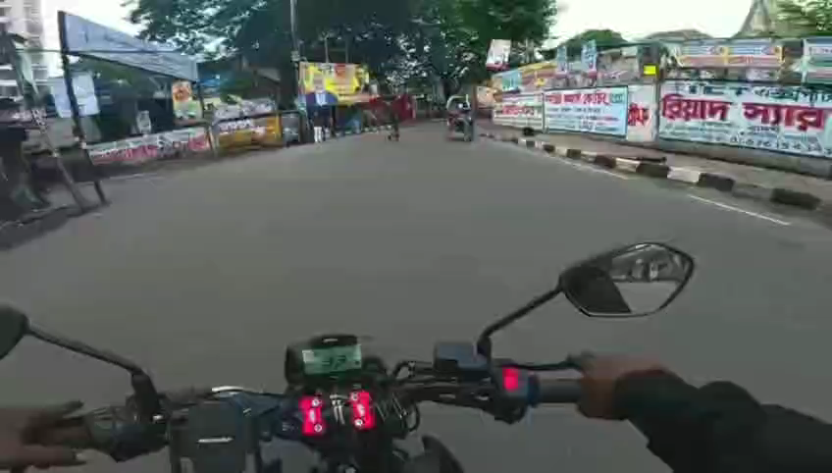
Some More Example ...

Slide 5
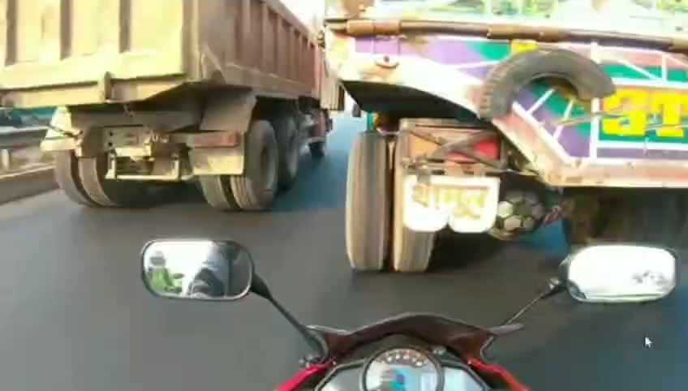
Vehicle Overtaking
This refers to two-wheeled vehicles (motorcycles and bicycles) passing other vehicles, often utilizing narrow gaps or "filtering" through slow or stationary traffic
According to our observation ​
Vehicle overtaking the road about 27 times from 8 videos.

Slide 6
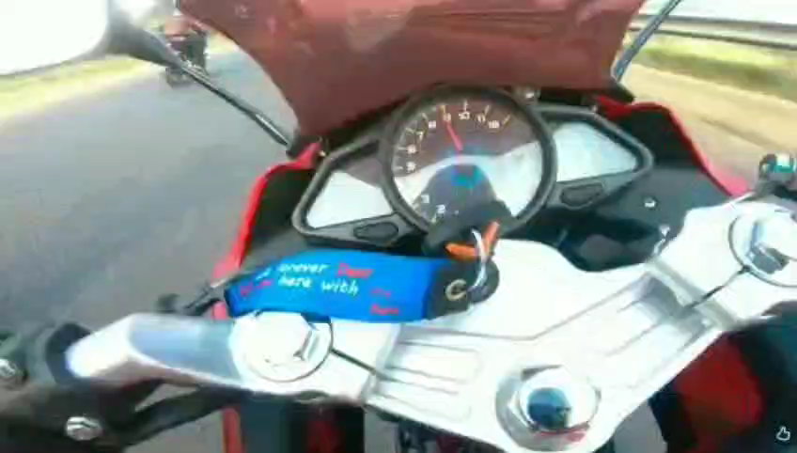
Some More Example….

Slide 7
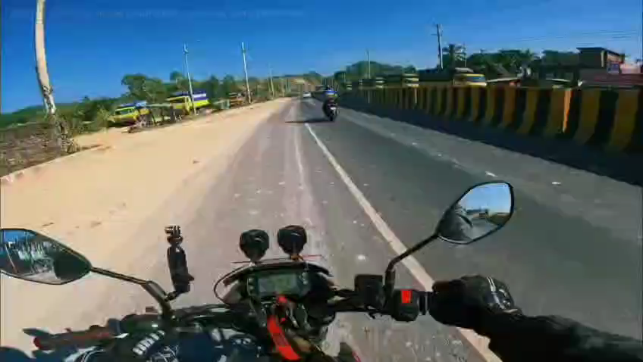
Speed Breakers /Bumps / Potholes
This refers to irregularities in the road surface that necessitate a reduction in speed to maintain vehicle control and prevent damage.
According to our observation
Speed breakers on the road about 8 times from 8 videos.

Slide 8
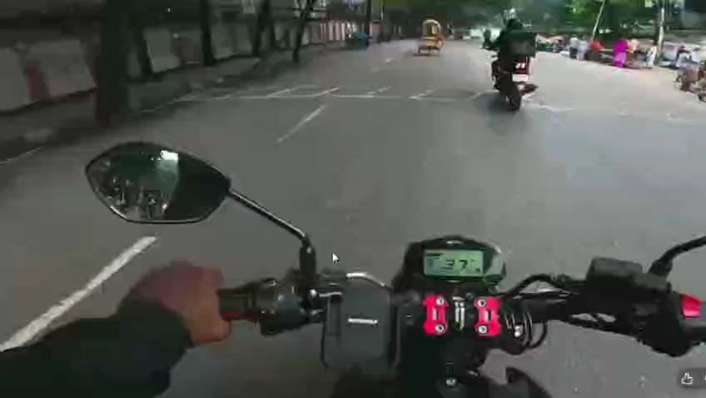
Some More Example …..

Slide 9
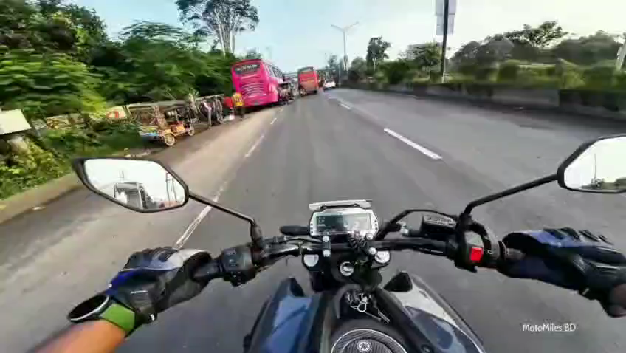
Vehicles Coming from the Opposite Lane
This typically refers to situations on a two-way road (without a median barrier) where oncoming traffic poses a collision threat, often due to improper overtaking or lane encroachment.
According to our observation
Vehicle coming from the opposite lane about 13 times from 8 videos.

Slide 10
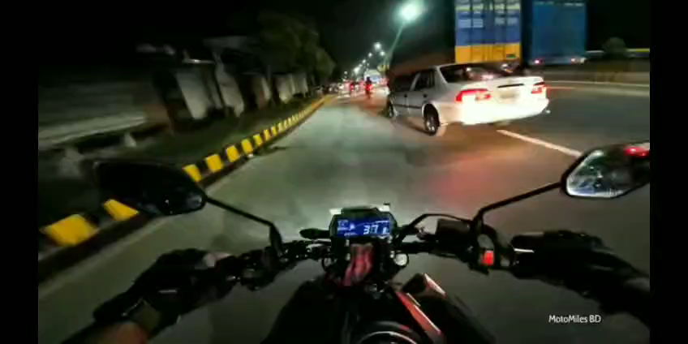
Some More Example …..

Slide 11
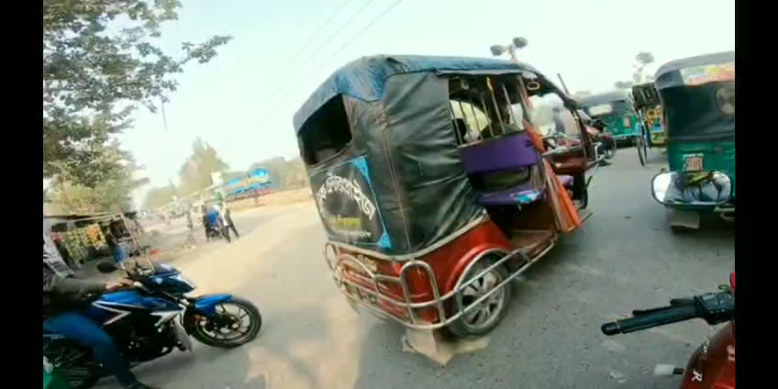
Railway track on middle of the road.
Railway tracks on the road surface pose a dual hazard
According to our observation
Railway track on middle of the road appeared 2 times in 8 videos.

Slide 12
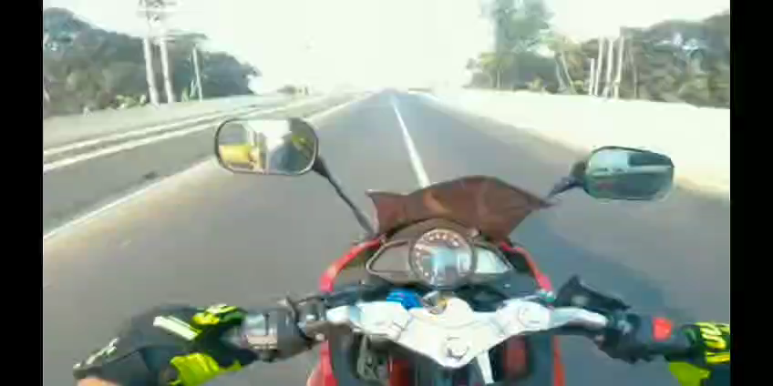
Some More Example….

Slide 13
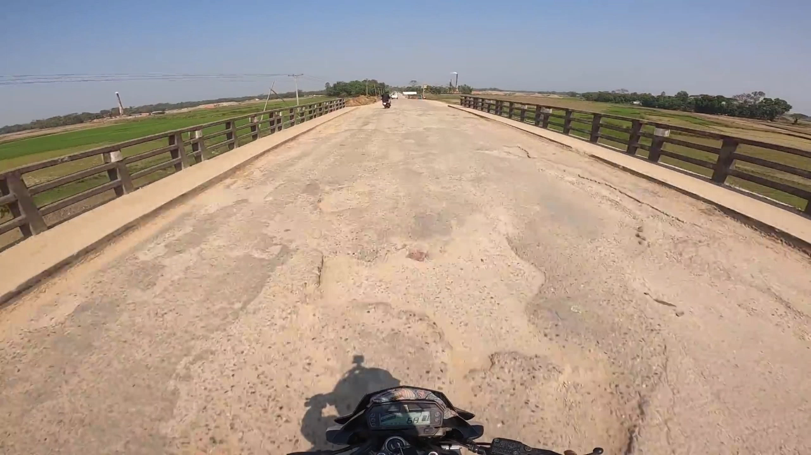
Motorbike Accident
A motorbike accident is a collision or incident involving a two-wheeled motorized vehicle, resulting in injury or damage.
According to our observation
Motorbike accident occurred 1 time in 8 videos.

Slide 14
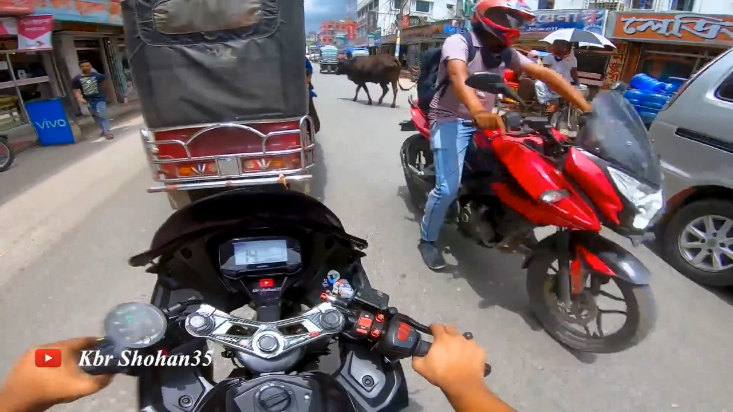
Animals Crossing the Road
Animals crossing the road creates an immediate and unpredictable hazard, demanding drivers slow down significantly and be prepared to stop instantly to prevent a collision
According to our observation ​
animal crossing the road occurred 2 times in 8 videos.​

Slide 15
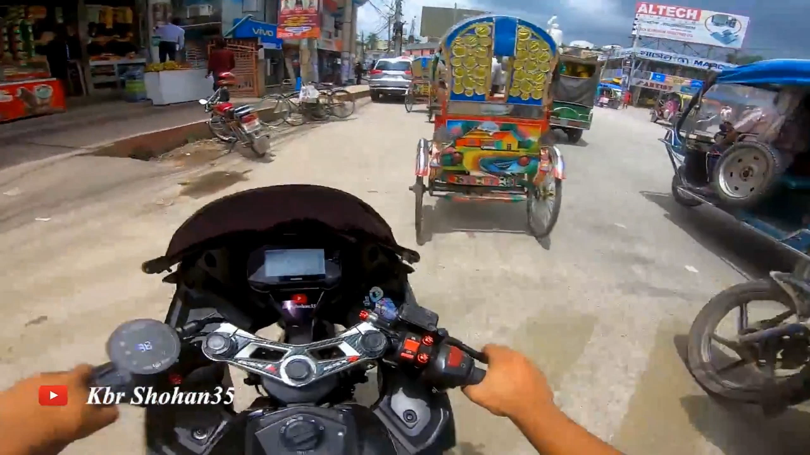
Some More Example …..

Slide 16
Thank You

